Slide 1
ELECTRICY PRODUCTION IN FRANCE (2006-2022)
The role of nuclear power and renewable energies
Noa Moal
BUT Informatique – 1er année
SAE 2.04

Slide 2
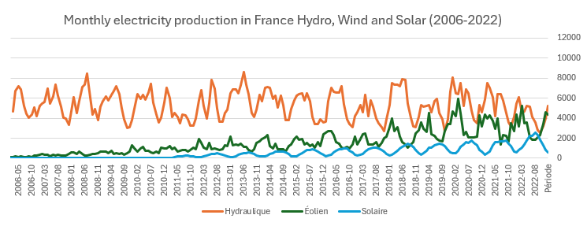
Monthly eletricity production in France

Slide 3
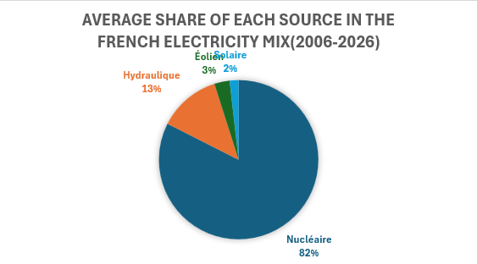
Average share of each source in the French electricity mix

